Slide 1
INVESTMENT CASE STUDY SUBMISSION
Name:
Pinaki Mahapatra

Slide 2
<Abstract>
Assignment Brief
As a member of Spark Funds, an asset management company, the aim is to understand the investment global trends and suggest best investment opportunities.
Below are the two main constraints the company has:
It wants to invest between 5 to 15 million USD per round of investment
It wants to invest only in English-speaking countries because of the ease of communication with the companies it would invest in
Aim is to analyze global market trends ,considering the ease of business and organizational investment constraints, and suggest the most invested sector.

Slide 3
<Problem solving methodology>
mappings
Unique values in companies
Key that can be used for merging
companies
Final Data-frame
Key = “category_list”
master_frame
Key = “permalink”
Top sector to invest in
Top countries to invest in
Top companies to invest in
Unique values in rounds2
Key that can be used for merging
countries in rounds2, not in companies
Number of observation in master_frame
rounds2

Slide 4
<Analysis>
Checkpoint 1 – Data Cleaning
Load the companies and rounds data into two data frames and name them companies and rounds2 respectively.
Find unique values in both the tables
Identify the key column which can be used as the unique key for each company
Merge the two data frames so that all variables (columns) in the companies frame are added to the rounds2 data frame. Name the merged frame master_frame.
Find the number of observations
Checkpoint 2 – Funding Type Analysis
Objective
Spark Funds wants to choose one of these four investment types for each potential investment they will make.
Considering the constraints of Spark Funds, you have to decide one funding type which is most suitable for them.
Calculating the most representative value of the investment amount for each of the four funding types (venture, angel, seed, and private equity)
Based on the most representative investment amount calculated above, identifying investment type which is the most suitable for Spark Funds.
Outcome
“VENTURE” was identified as the most suitable Investment Type

Slide 5
<Analysis>
Checkpoint 3 – Country Analysis
Objective
Spark Funds wants to invest in countries with the highest amount of funding for the chosen investment type. This is a part of its broader strategy to invest where most investments are occurring.
Spark Funds wants to see the top nine countries which have received the highest total funding (across ALL sectors for the chosen investment type)
For the chosen investment type, make a data frame named top9 with the top nine countries (based on the total investment amount each country has received)
Outcome
United States, United kingdom and India were identified as the top three countries, Spark Funds should invest in.
Checkpoint 4 – Sector Analysis
Objective
To sort the sector of various industries which has been funded. This will give a better understanding which sector is better to invest in.
To get a merged data-frame with various investment details as well as sector information
Outcome
The master-frame and mappings data-frames were merged.
The new data-frame had both investment and sector details.

Slide 6
<Analysis>
Checkpoint 5 – Sector Analysis
Objective
The aim is to find out the most heavily invested main sectors in each of the three top countries (for funding type FT and investments range of 5-15 M USD).
Outcome
Created three separate data frames D1, D2 and D3 for each of the three countries containing the observations of funding type FT falling within the 5-15 million USD range. The three data frames should contain:
All the columns of the master_frame along with the primary sector and the main sector were present
The total number (or count) of investments for each main sector in a separate column were calculated
Checkpoint 6 - Plots
Objective
To plot various charts, to get a better understanding of the analyzed data

Slide 7
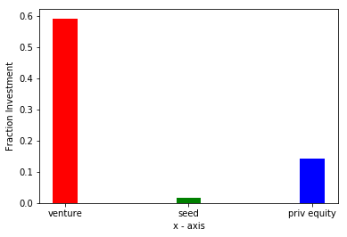
<Results>
Plot 1

Slide 8
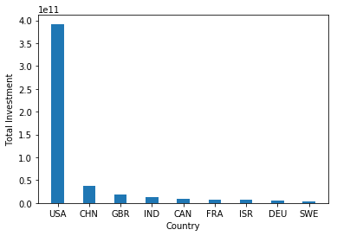
<Results>
Plot 2

Slide 9
<Results>
Plot 3

Slide 10
<Conclusions>

